Slide 1

WEB Development
Grade 7&8

Slide 2
Recap of the last Class
Notes:
Objective:
Review the previous lesson on HTML lists.
Introduce the new topic: HTML tables.
Teacher Instructions:
Recap the key points from the last lesson:
Ordered lists are numbered.
Unordered lists use bullet points.
Introduce today's topic:
Explain that today, students will learn about tables in HTML.
Mention that tables are useful for organizing data into rows and columns.

Slide 3
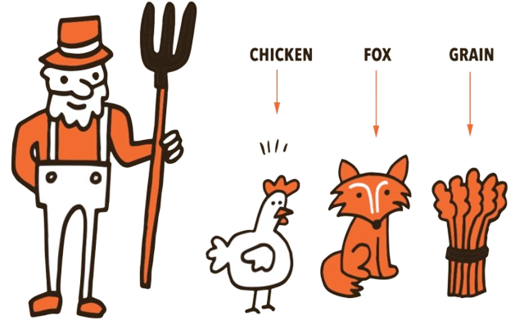
The River Crossing
You have a fox, a chicken, and a sack of grain. You need to cross a river, but your boat can only carry you and one item at a time. If you leave the fox alone with the chicken, the fox will eat the chicken. If you leave the chicken alone with the grain, the chicken will eat the grain. How can you transport all three items across the river without any of them being eaten?
Notes:
Answer: First, take the chicken across. Then, go back alone and take the fox across. Leave the fox on the other side but take the chicken back. Leave the chicken, and take the grain across. Finally, go back alone and take the chicken across. Objective:
Engage students with a problem-solving activity.
Teacher Instructions:
Present the riddle:
"You have a fox, a chicken, and a sack of grain. You need to cross a river, but your boat can only carry you and one item at a time. If you leave the fox alone with the chicken, the fox will eat the chicken. If you leave the chicken alone with the grain, the chicken will eat the grain. How can you transport all three items across the river without any of them being eaten?"
Discuss possible solutions and encourage creative thinking.

Slide 4

Introduction to Tables
Notes:
Objective:
Introduce the concept of tables in HTML.
Teacher Instructions:
Show the image attached to the slide.
Explain the purpose of tables:
"Tables help us organize data neatly into rows and columns, making it easier to read and understand."

Slide 5
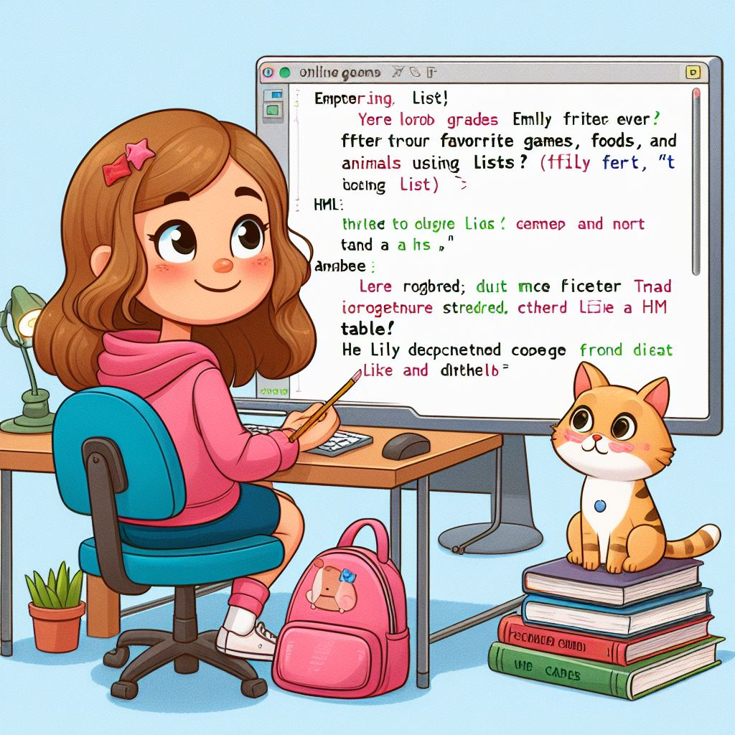
The game of discipline: Table
Emily, a curious fifth-grader, loved online games and joined an HTML class to learn more. After mastering lists, she tried to organize her favorite games, foods, and animals using lists, but it didn't look right. She wanted something more organized, like a table.
Her teacher, introduced tables in the next lesson. He explained how tables organize data into rows and columns, like a spreadsheet. Lily decided to give it a try.
Let's code along with lily and explore the Tables.
Notes:
Objective:
Provide a relatable context for learning tables in HTML.
Teacher Instructions:
Share Emily's story:
"Emily, a curious fifth-grader, loved online games and joined an HTML class. After mastering lists, she wanted to organize her favorite games, foods, and animals more neatly, like a table."
Explain how tables are used:
"Tables organize data into rows and columns, similar to a spreadsheet."
Set the task:
"Let's code along with Emily and explore how to create tables in HTML."

Slide 6
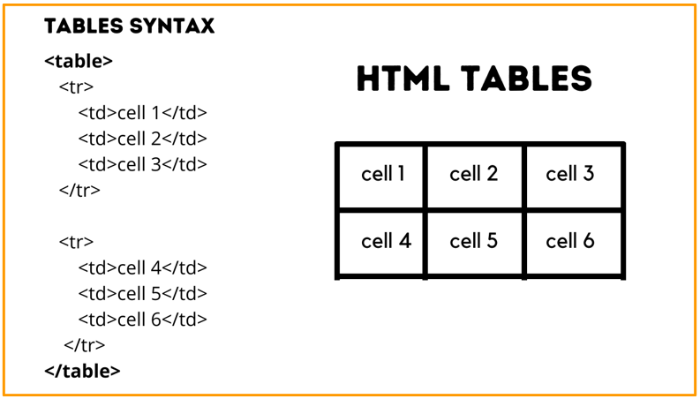
Introduction to Tables
HTML tables allow us to arrange data into rows and columns.
How it Looks:
Notes:
Objective:
Explain the basic structure of HTML tables.
Teacher Instructions:
Show the screenshot of the table syntax.
Explain the key elements of a table:
"<table>: This tag defines the start of a table."
"<tr>: This tag defines a table row."
"<th>: This tag defines a table header."
"<td>: This tag defines a table cell (data)."

Slide 7
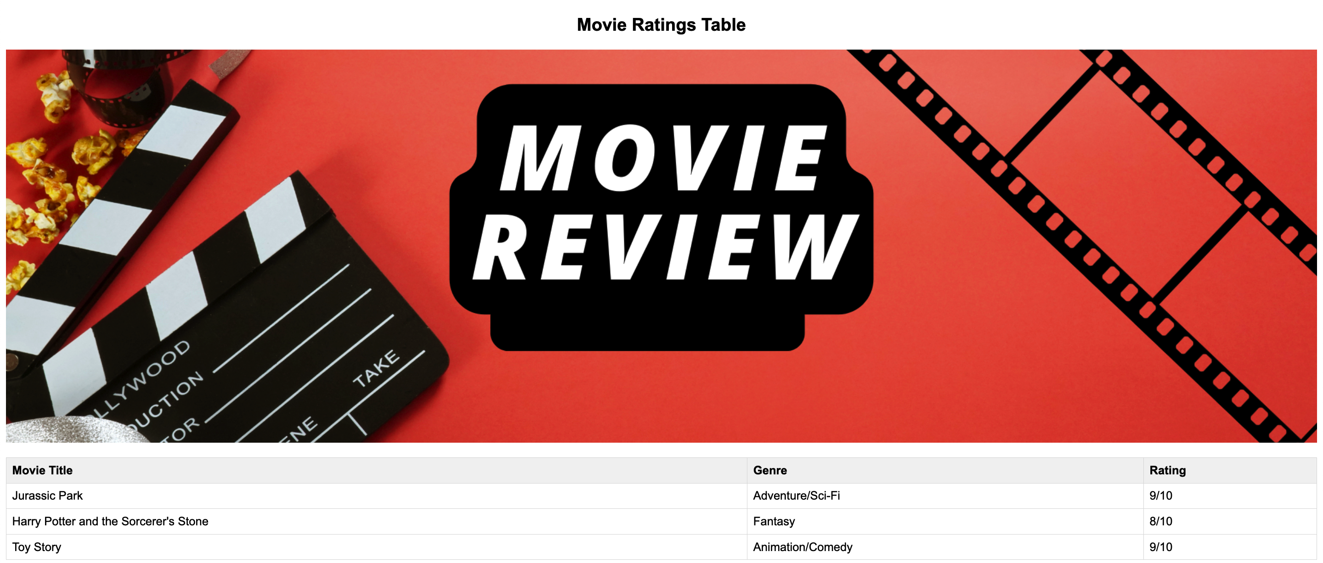
Project – Movie Ratings Table
Notes:
Project Link: https://replit.com/@vijayselfcode/Project-Class-8-G-5and6
Objective:
Present the final project example.
Teacher Instructions:
Show the screenshot of the final project.
Explain that students will create a similar project.

Slide 8
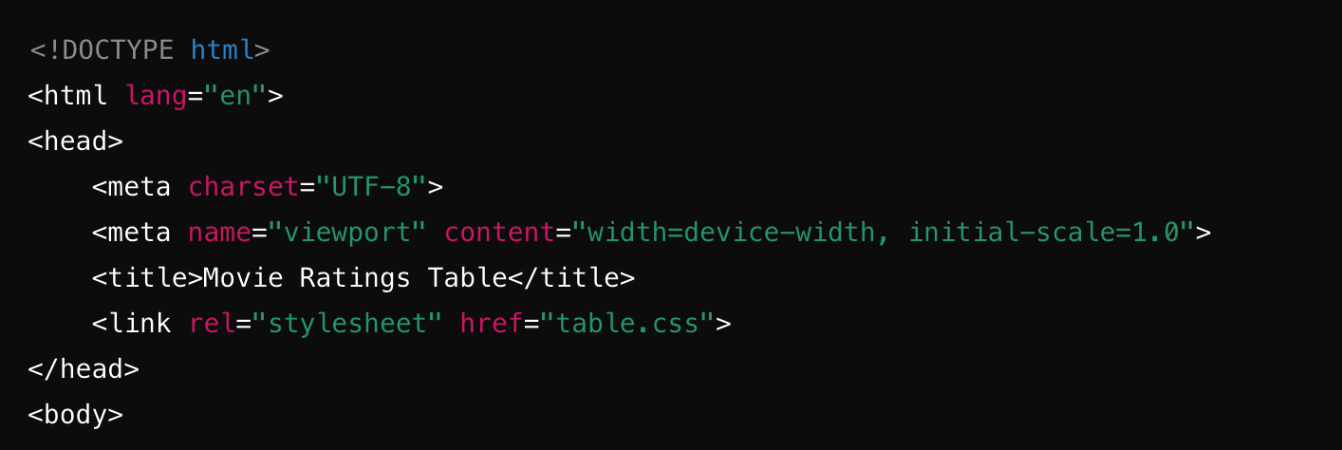
Working with the Project
HTML Code Explanation
Basic Structure of an HTML Document
Notes:
"Teacher's Activity"
Objective:
Explain the basic structure of an HTML document.
Teacher Instructions:
Display the screenshot of the HTML code.
Provide an overview of the basic structure:
<!DOCTYPE html>: Specifies HTML5.
<html lang="en">: Starts the HTML document with English language.
<head>: Contains meta-information.
Various meta tags for character set, viewport, and title.
<link>: Links to an external CSS file.

Slide 9
Working with the Project
Basic Structure of an HTML Document
<!DOCTYPE html> : This tells the web browser that we are using HTML5.
<html lang="en"> : This starts our HTML document and sets the language to English.
<head> : This section contains important information about our web page that we don't see on the page itself.
<meta charset="UTF-8"> : This ensures our page can display all kinds of text characters correctly.
<meta name="viewport" content="width=device-width, initial-scale=1.0"> : This makes sure our page looks good on all devices, like computers and phones.
<title>Movie Ratings Table</title> : This sets the title of our web page, which appears in the browser tab.
<link rel="stylesheet" href="table.css"> : This connects our HTML to a CSS file called table.css to style our page.
Notes:
Objective:
Explain the structure of the HTML document's head section.
Teacher Instructions:
Display the screenshot of the HTML code.
Explain the purpose of each element in the head section:
<!DOCTYPE html>, <html lang="en">, <head>: Basic document structure.
Various meta tags: Specify character set, viewport settings, and page title.
<link>: Links to an external CSS file for styling.

Slide 10
Working with the Project
Body of the HTML Document
<h2 id="title1">Movie Ratings Table</h2> : This creates a big heading (like a title) on our page that says "Movie Ratings Table".
Notes:
Objective:
Explain the body of the HTML document.
Teacher Instructions:
Display the screenshot of the HTML code.
Explain the body content:
<h2 id="title1">: Heading for the movie ratings table.

Slide 11
Working with the Project
Adding an Image
<img src="/movie.png" alt="Movie Night" class="intro-image"> : This adds an image to our page. The src attribute tells the browser where to find the image. The alt attribute provides a text description of the image, and the class helps us style the image with CSS.
Notes:
Objective:
Explain how to add an image to the HTML document.
Teacher Instructions:
Display the screenshot of the HTML code.
Explain the image element:
<img src="/movie.png" alt="Movie Night" class="intro-image">: Adds an image with specified source, alternate text, and class for styling.

Slide 12
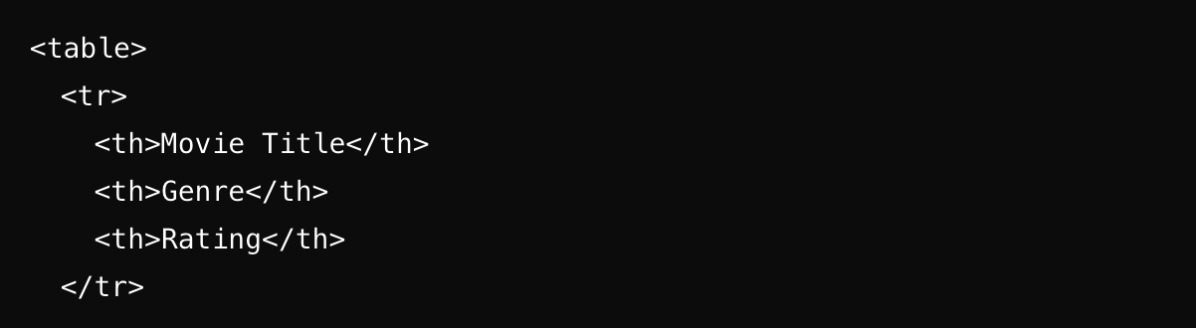
Working with the Project
Creating the Table: Part 1 - Table and Header Row
Notes:
Objective:
Explain how to create the table and header row.
Teacher Instructions:
Display the screenshot of the HTML code.
Explain the table structure:
<table>: Starts the table.
<tr>: Creates a table row.
<th>: Creates header cells for column headings.
</tr>: Ends the header row.

Slide 13
Working with the Project
Creating the Table: Part 1 - Table and Header Row
<table> : This starts our table.
<tr> : This stands for "table row" and it creates a row in our table.
<th> : This stands for "table header" and it creates a header cell. These are the headings for each column in our table. In this part, we have three header cells: "Movie Title", "Genre", and "Rating".
</tr> : This ends the header row.
Notes:
Objective:
Continue explaining the table creation process.
Teacher Instructions:
Display the screenshot of the HTML code.
Explain the table header structure:
<table>, <tr>, <th>: Basic table structure.
Content inside <th> tags: Column headings.
</tr>: Ends the header row.

Slide 14
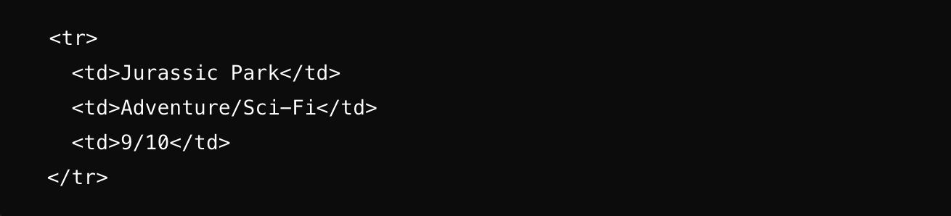
Working with the Project
Creating the Table: Part 2 - First Row of Data
Notes:
Objective:
Explain how to create the first row of data in the table.
Teacher Instructions:
Display the screenshot of the HTML code.
Explain the table row and data cells:
<tr>: Starts a new row.
<td>: Creates regular cells for data.
Content inside <td> tags: Movie information for "Jurassic Park".

Slide 15
Working with the Project
Creating the Table: Part 2 - First Row of Data
<tr> : This creates a new row in our table.
<td> : This stands for "table data" and it creates a regular cell in our table. Each cell contains a piece of information about the movie "Jurassic Park". The cells have the title, genre, and rating of the movie.
Notes:
Objective:
Continue explaining the table creation process.
Teacher Instructions:
Display the screenshot of the HTML code.
Explain the structure of the first row of data:
<tr>: Starts a new row.
<td>: Contains movie information for "Jurassic Park".

Slide 16
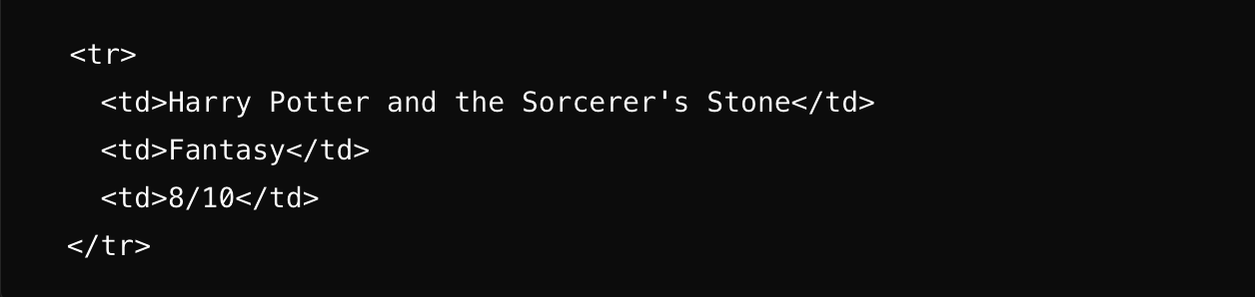
Working with the Project
Creating the Table: Part 3 - Second Row of Data
Notes:
Objective:
Explain how to create the second row of data in the table.
Teacher Instructions:
Display the screenshot of the HTML code.
Explain the table row and data cells:
<tr>: Starts a new row.
<td>: Creates regular cells for data.
Content inside <td> tags: Movie information for "Harry Potter and the Sorcerer's Stone".

Slide 17
Working with the Project
Creating the Table: Part 3 - Second Row of Data
<tr> : This creates another new row in our table.
<td> : Each cell in this row contains a piece of information about the movie "Harry Potter and the Sorcerer's Stone". The cells have the title, genre, and rating of the movie.
Notes:
Objective:
Continue explaining the table creation process.
Teacher Instructions:
Display the screenshot of the HTML code.
Explain the structure of the second row of data:
<tr>: Starts a new row.
<td>: Contains movie information for "Harry Potter and the Sorcerer's Stone".

Slide 18
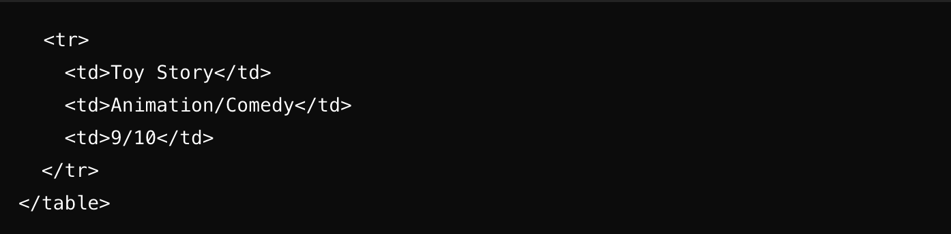
Working with the Project
Creating the Table: Part 4 - Last Row of Data and Closing the Table
Notes:
Objective:
Explain how to create the last row of data and close the table.
Teacher Instructions:
Display the screenshot of the HTML code.
Explain the table row and data cells:
<tr>: Starts a new row for the last movie.
<td>: Contains movie information for "Toy Story".
</table>: Closes the table.

Slide 19
Working with the Project
Creating the Table: Part 4 - Last Row of Data and Closing the Table
<tr> : This creates another new row in our table for the last movie.
<td> : Each cell in this row contains the title, genre, and rating for "Toy Story".
</table> : This ends our table.
Notes:
Objective:
Continue explaining the table creation process.
Teacher Instructions:
Display the screenshot of the HTML code.
Explain the structure of the last row of data and the closing of the table:
<tr>: Starts a new row.
<td>: Contains movie information for "Toy Story".
</table>: Ends the table.

Slide 20
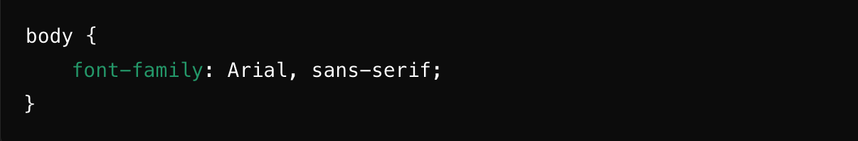
Working with the Project
CSS Code Explanation
Styling the Body
body: This is the main part of our web page.
font-family: Arial, sans-serif; : This sets the font style for our page to Arial, which is a type of text.
Notes:
Objective:
Explain the CSS code for styling the body of the webpage.
Teacher Instructions:
Display the screenshot of the CSS code.
Explain the styling for the body:
body: Sets the main styling for the webpage.
font-family: Specifies the font style for text.

Slide 21
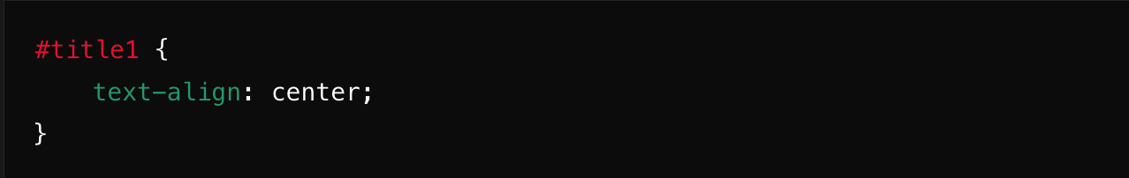
Working with the Project
Styling the Title
#title1 : This targets the element with the ID "title1".
text-align: center; : This centers the text of our title.
Notes:
Objective:
Explain the CSS code for styling the title.
Teacher Instructions:
Display the screenshot of the CSS code.
Explain the styling for the title:
#title1: Targets the element with the ID "title1".
text-align: Centers the text of the title.

Slide 22
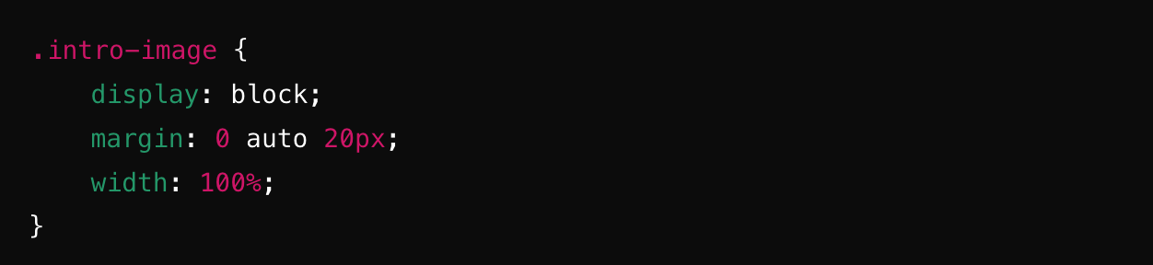
Working with the Project
Styling the Image
.intro-image : This targets the element with the class "intro-image".
display: block; : This makes sure the image is treated as a block element, so it can be centered.
margin: 0 auto 20px; : This centers the image horizontally and adds some space below it.
width: 100%; : This makes the image as wide as the page.
Notes:
Objective:
Explain the CSS code for styling the image.
Teacher Instructions:
Display the screenshot of the CSS code.
Explain the styling for the image:
.intro-image: Targets the element with the class "intro-image".
display: block: Treats the image as a block element.
margin: Centers the image horizontally and adds space below it.
width: Sets the image width to 100% of the page.

Slide 23
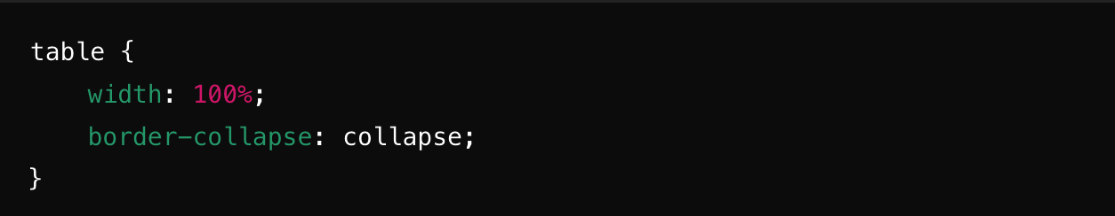
Working with the Project
Styling the Table
table: This targets the table element.
width: 100%; : This makes the table as wide as the page.
border-collapse: collapse; : This removes the space between the table cells, so they look like one continuous table.
Notes:
Objective:
Explain the CSS code for styling the table.
Teacher Instructions:
Display the screenshot of the CSS code.
Explain the styling for the table:
table: Targets the table element.
width: Sets the table width to 100% of the page.
border-collapse: Collapses the borders between table cells.

Slide 24
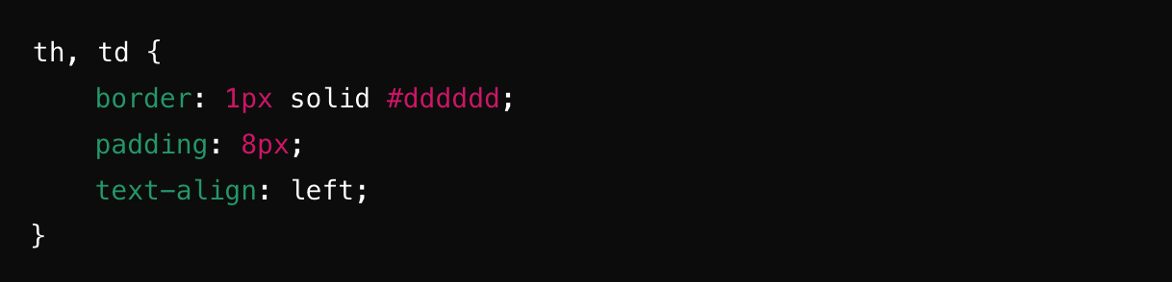
Working with the Project
Styling the Table Cells
th, td : This targets both header cells (th) and regular cells (td).
Border : 1px solid #dddddd;: This adds a light gray border around each cell.
padding: 8px; : This adds some space inside each cell.
text-align: left; : This aligns the text inside each cell to the left.
Notes:
Objective:
Explain the CSS code for styling the table cells.
Teacher Instructions:
Display the screenshot of the CSS code.
Explain the styling for table cells:
th, td: Targets both header cells and regular cells.
Border, padding, text-align: Adds border, padding, and aligns text within cells.

Slide 25
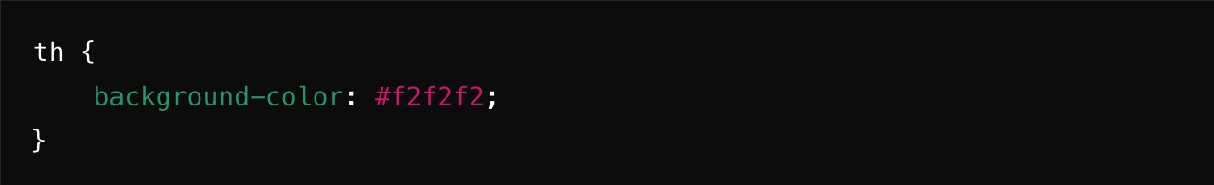
Working with the Project
Styling the Table Headers
th : This targets the header cells.
background-color: #f2f2f2; : This gives the header cells a light gray background color.
Notes:
Objective:
Explain the CSS code for styling the table headers.
Teacher Instructions:
Display the screenshot of the CSS code.
Explain the styling for table headers:
th: Targets the header cells.
background-color: Sets background color for header cells.

Slide 26
Now it's your turn!
Task: Add a few more of your favorite movies to the table and rate them based on your preferences.
Instructions: Examine the code of the selected webpage and create additional cells in the table to include your movies. Adjust the CSS of the webpage to modify or enhance the color values, aiming for a more visually appealing and user-friendly design.
Notes:
"Students' Activity"
Objective:
Engage students in a hands-on activity to reinforce learning.
Teacher Instructions:
Present the student activity task:
Adding favorite movies to the table and rating them.
Provide instructions for the activity:
Review the existing code and identify where to add new movie data.
Adjust CSS properties to enhance the visual design of the webpage.

Slide 27

How to Save & Share the project.
Replit offers autosave option – so not worry about the same.
To share project with someone in view mode: just copy the link from the URL bar, and share the link
To share the project for collaboration
Click on "Invite" from the top right corner
If you know the username, type it in the box and click on invite
You can also turn on the toggle button "private join link" to create a public collaboration link and invite members to edit your code.
Notes:
Instructions for the Teacher:
Explain how to save and share projects on Replit, including the options for collaboration.
Emphasize the importance of sharing projects for feedback and collaboration.

Slide 28


What is the main purpose of using tables in HTML?
a) To organize data into rows and columns
b) To display images on the website
c) To create hyperlinks
d) To change text font and color
Notes:
Answer: a) To organize data into rows and columns

Slide 29
Which tag is used to create a new row in an HTML table?
a) <tr>
b) <td>
c) <table>
d) <th>
Notes:
Answer: a) <tr>

Slide 30
What tag is used to create a table heading?
a) <th>
b) <td>
c) <tr>
d) <table>
Notes:
Answer: a) <th>

Slide 31
What can be placed inside a table cell (<td>) in HTML?
a) Text and images
b) Video files
c) Audio files
d) Animation sequences
Notes:
Answer: a) Text and images

Slide 32

What have we learnt?
Today We Learned:
How to create a movie ratings table using HTML and CSS. We focused on structuring the table with movie titles, genres, and ratings. Additionally, we practiced applying basic styling to enhance the table's appearance
Notes:
Objective:
Summarize the key learnings from the lesson.
Teacher Instructions:
Review the key points learned in the lesson:
Creating a movie ratings table using HTML and CSS.
Structuring the table with movie titles, genres, and ratings.
Applying basic styling to enhance the table's appearance.

Slide 33

Homework Discussion
Notes:
Instructions for the Teacher: Facilitate a discussion about the homework assignment.

Slide 34

Brain Booster Bonus
Make a weekly class schedule using HTML tables.
Use "colspan" and "rowspan" to join boxes for subjects that last for more than one day or hour.
Make the table look nice with CSS by using border, padding, and margin.
Add subject names, teacher names, and classroom numbers.
Notes:
Objective:
Provide an extra challenge for students to apply their knowledge creatively.
Teacher Instructions:
Present the Brain Booster Bonus challenge:
Creating a weekly class schedule using HTML tables.
Using "colspan" and "rowspan" for multi-day or multi-hour subjects.
Styling the table with CSS for improved visual appeal.
Encourage students to include subject names, teacher names, and classroom numbers in their schedules.

Slide 35

Be Skeptical of Promises
If something online sounds too good to be true, like 'free games for life,' it could be a trick.
Oliver saw an ad online promising "free games for life" and eagerly clicked on it, hoping for a great deal.
Instead, his computer got infected with malware, causing a lot of problems.
The moral of the story: don't believe ads or emails promising free stuff without checking with an adult first, as it could be a trick.

